Slide 1
Python Inheritance Type : Multilevel PART - 2
In Tamil
By
Monisha S

Slide 2
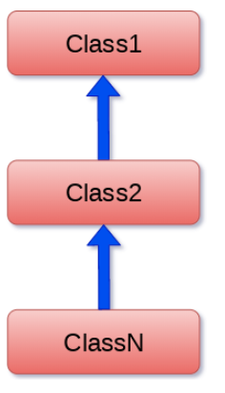
MULTILEVEL INHERITANCE
In multilevel inheritance, features of the base class and the derived class are further inherited into the new derived class. This is similar to a relationship representing a child and a grandfather.
Syntax:
class class1:
<class-suite>
class class2(class1):
<class suite>
class class3(class2):
<class suite>

